Slide 1


Slide 2


2021 Community Health
Needs Assessment
Colleen Milligan, MBA
Danielle Walters, MPH

Slide 3






The YNHHS 2022 CHNA Project Team
Colleen Milligan, MBA
Danielle Walters, MPH
Catherine Birdsey, MPH
Grace Gorenflo, RN, MPH
Priyanka Dhamane, MPH
Genay Jackson, MPH
Seasoned team has conducted CHNAs for more than 150 hospitals, public health departments, and their partners
Expertise in healthcare delivery, epidemiology, population health management, community engagement, program development and evaluation, capacity building, data analytics, and survey administration
Backgrounds in social justice work; understand the intersection of social drivers of health and health equity
Believe in collective impact model, community based participatory research (CBPR), value of inviting wide participation to define and solve challenges with the people who experience them
Respected field leaders; have helped develop tools for data collection and planning that have been widely adopted as best practices

Slide 4
Overview of CHNA Findings
March 25, 2022

Slide 5
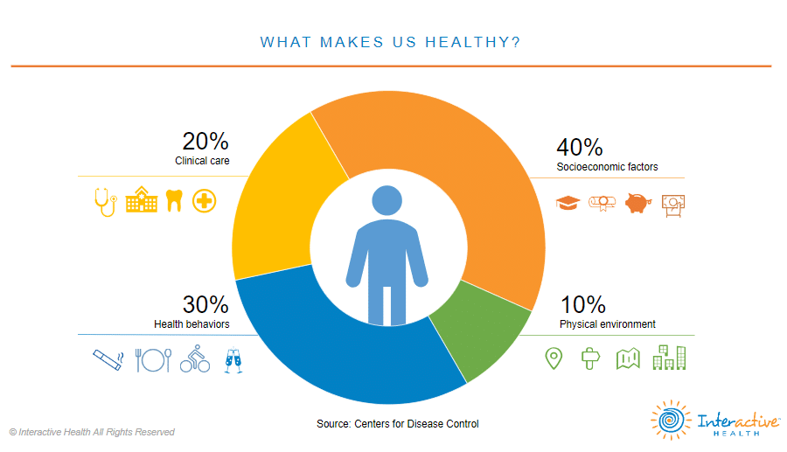


Slide 6
Where We Live Matters

Slide 7

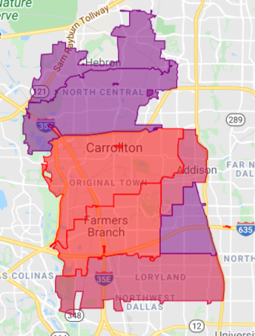
Community Needs Index
The CNI indicates demand for health resources in a community
Education is a
pathway to
financial security
Zip Code | Town | CNI Score
75019 | Coppell | 2.6
75010 | Carrollton | 3
75244 | Farmer’s Branch | 3
75007 | Carrollton | 3.2
75001 | Addison | 3.4
75234 | Farmer’s Branch | 4.2
75006 | Carrollton | 4.4

Slide 8
Key Stakeholder Perspectives:
Social Drivers of Health

Slide 9
The Metrocrest Area is Growing
Source: American Community Survey

Slide 10
The Metrocrest Population is Aging
Generation | Gen X | Boomers | Boomers/ Silent | Median Age
Age as of 2019 | 45-54 years | 55-64 years | 65 years and over
Addison, 75001 | 11% | 11% | 7% | 32
Carrollton, 75006 | 12% | 13% | 12% | 35
Carrollton, 75007 | 16% | 15% | 12% | 40
Carrollton, 75010 | 16% | 12% | 9% | 36
Farmers Branch, 75234 | 15% | 11% | 12% | 37
Farmers Branch, 75244 | 14% | 12% | 15% | 38
Coppell, 75019 | 18% | 8% | 9% | 41
Dallas County | 13% | 11% | 11% | 33
Denton County | 14% | 6% | 11% | 36
Texas | 13% | 11% | 12% | 35
United States | 13% | 13% | 16% | 38
Current and anticipated older adult population will impact future service needs and healthcare demands
Chronic Diseases such as Alzheimer's require medical maintenance and social support

Slide 11
ALICE Lives in all Metrocrest Communities
In 2018, roughly 1 in 4 households had income but did not earn enough to meet basic needs

Slide 12
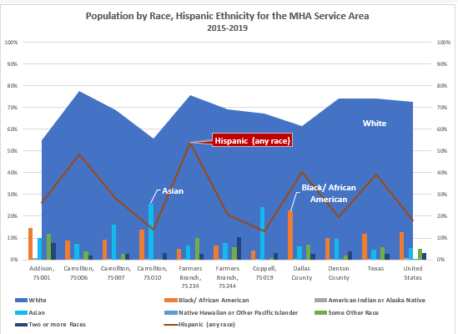
The Metrocrest Area is diverse and people’s experiences vary widely.

Slide 13
Students in CFBISD Reflect that Diversity
More than half of all CFBISD Students Qualify for Free or Reduced Lunch
CFBISD
Racial and Ethnic Demographics
CFBISD
Children Eligible for Free and Reduced-Price Lunch
 | Enrolled Students | Percent of Total Students
2019-2020 School Year | 16,421 | 64.1%
2018-2019 School Year | 16,565 | 64.7%

Slide 14
Maternal & Child Health
 | First Trimester Prenatal Care | Premature Births | Percent Low or Very Low Birth Weight Births
Addison, 75001 | 58.30% | 6.00% | 5.00%
Carrollton, 75006 | 59.10% | 9.70% | 7.00%
Carrollton, 75007 | 58.50% | 9.20% | 7.40%
Carrollton, 75010 | 63.90% | 11.50% | 10.10%
Farmers Branch, 75234 | 60.90% | 10.00% | 8.70%
Farmers Branch, 75244 | 76.10% | 7.50% | 6.90%
Coppell, 75019 | 73.30% | 9.10% | 6.40%
Dallas County | 54.60% | 11.50% | 8.70%
Denton County | 67.40% | 9.80% | 8.00%
Texas | 60.50% | 12.20% | 8.40%
United States | 77.30% | 9.90% | 9.70%
Early prenatal care is a key indicator for current and future health of moms and babies.
There are few local options for obstetrics care.

Slide 15
A high incidence rate and low death rate suggests that cancers are being diagnosed and treated at an earlier stage.
Chronic Disease Example: Cancer
Early Detection Matters
Cancer Incidence and Death Rates by Type per 100,000*
 | Female Breast Cancer |  | Colorectal Cancer |  | Lung Cancer |  | Prostate Cancer
 | Incidence | Death | Incidence | Death | Incidence | Death | Incidence | Death
Dallas County | 118.8 | 21.2 | 38.2 | 14.7 | 49.2 | 32.3 | 98.4 | 19.6
Denton County | 127.0 | 17.5 | 31.8 | 10.9 | 46.7 | 30.8 | 103.6 | 15.6
Texas | 112.8 | 19.8 | 37.6 | 13.9 | 50.6 | 34.1 | 94.0 | 17.6
United States | 125.9 | 20.1 | 38.4 | 13.7 | 58.3 | 38.5 | 104.5 | 19.0
Healthy People 2030 | NA | 15.3 | NA | 8.9 | NA | 25.1 | NA | 16.9
Source: National Cancer Institute, 2013-2017 *Death rates are age-adjusted per 100,000.

Slide 16
Identifying Disparity: Cancer Death Rates
The causes of disparity are complex but can be addressed
Source: National Cancer Institute, 2013-2017 *Death rates are age-adjusted per 100,000.

Slide 17
Top barriers identified by Key Stakeholders
Named as #1 Top Issue
Access to Health care
Economic security
Housing
Mental Health
Increase awareness of services
Mentioned Within Top 3 Issues
Health care, including access to primary, mental health, dental care
Economics, including housing, food, utilities, employment
Increase cultural competencies
Education attainment
Transportation

Slide 18
CHNA Areas of Opportunity
Behavioral health for youth
  Needs outpacing existing services
  Socioeconomic needs>trauma>ACEs
  Language barriers for families
  School drop due to socioeconomic needs
  Low pay for existing program staff>staff turnover>disconnect
Socioeconomic needs: food security, housing
  High COVID impact on families
  Need for affordable housing
  Homelessness
Prenatal care and birth outcomes
  Lack of local services
  Low % of first trimester prenatal care
  Disparities in birth outcomes for Black mothers and infants
Primary care: early detection and treatment for chronic disease
  BIPOC, disparities in death rates
  Cultural competencies, building trust
  Uninsured, undocumented
  Lack of dental care, vision care
  Medical home for students, family
  Local access to specialty care referrals
Educate policy makers on impact of social determinants of health
  Economic impact
  Long-term costs to community/future health spending
  Expansion to SNAP, WIC, health insurance

Slide 19
Focus Areas for Impact
Socioeconomic Needs: Respond to socioeconomic needs increased through COVID
Access: Increase access to health care and social services
Behavioral Health: Increase community competence for behavioral health
Invest in health early: Increase percentage of mothers that receive prenatal care in their first trimester
Policy: Educate policymakers on the impact of social determinants of health

Slide 20
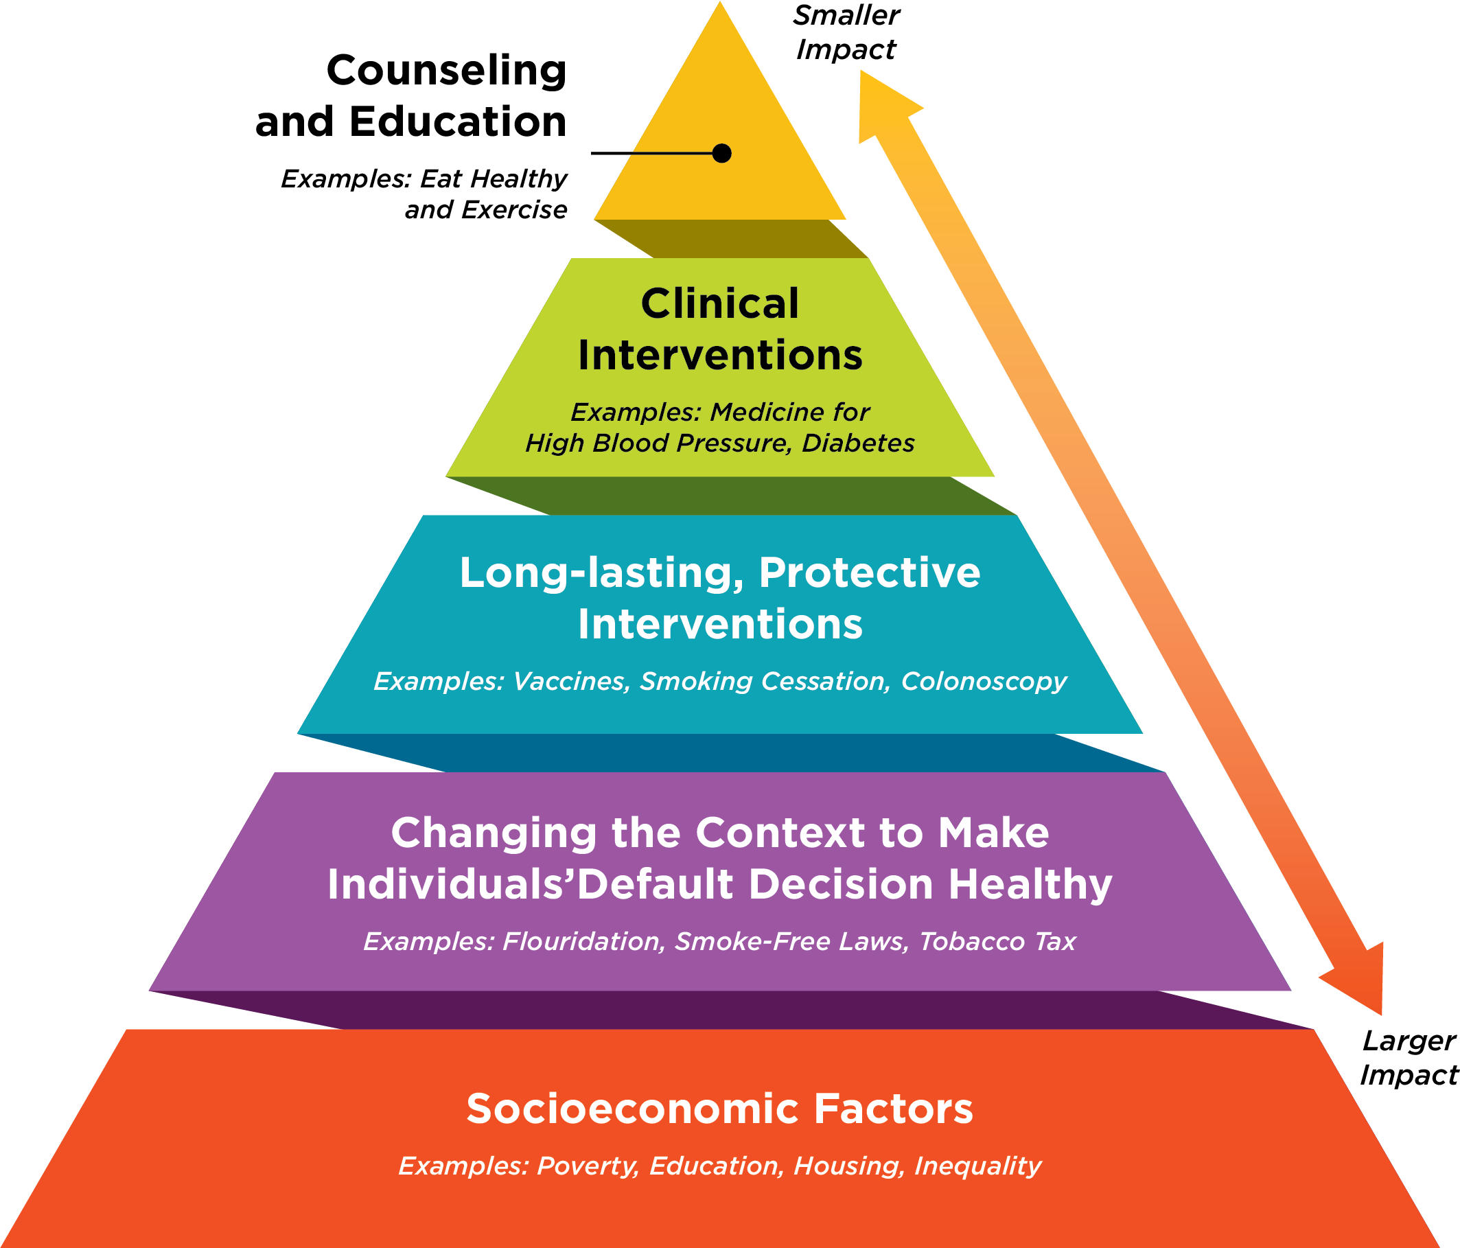
Health Impact
Pyramid

Slide 21
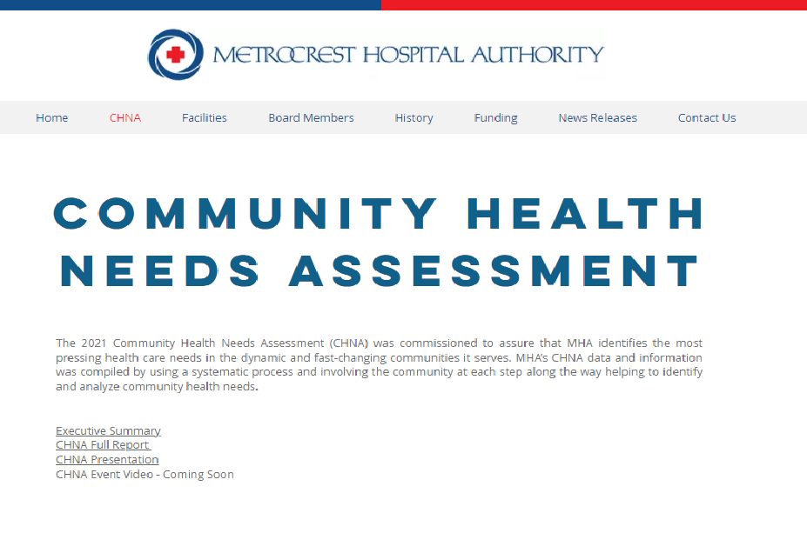

https://www.mhatx.org

